Slide 1
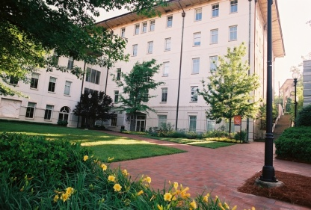


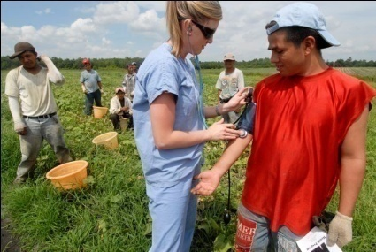
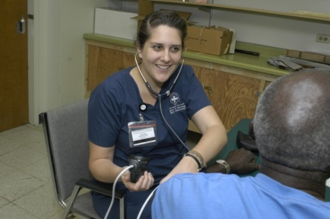
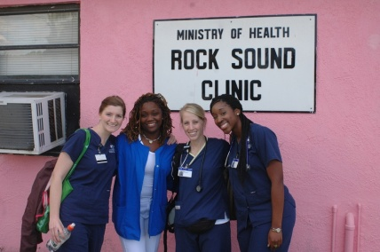
Kaleidoscope: Twists and Turns in Big Data
Roy L. Simpson, DNP, RN, DPNAP, FAAN, FACMI

Slide 2
Conflicts of Interest
I have no actual or potential conflict of interest in relation to this program/presentation.
Roy L. Simpson DNP, RN, DPNAP, FAAN, FACMI
Asst Dean and Professor
Emory University
Nell Hodgson School of Nursing

Slide 3

This session will focus on defining big data, exemplars of growth in big data in the world of “omics” for nurses and nursing future in big data, and the role of the nursing informaticist in the turning and twisting of the kaleidoscope.
Notes:
Demonstrate the value of Big Data to Nursing practice and research
Carve out a place for compassion in a capitalistic society
Explain three steps every nurse can take today to advance the profession through advocacy
Big data/teenage sex quote
Share example of data science and its importance
Intersection of the fields of social science and statistics, information and computer science, and design…and nursing

Slide 6
Origin of the Term
Proceedings of the 8th conference on Visualization '97 Pages 235-ff.

Slide 7
Origin of the Term
It is from this paper that use of the term entered the mainstream.

Slide 8
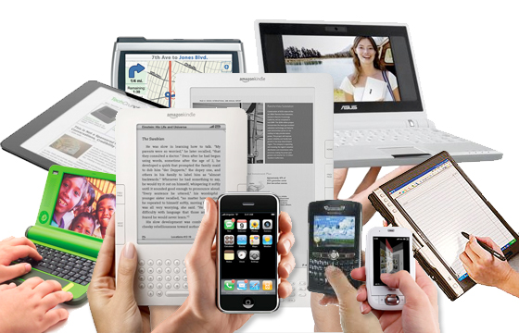
Data Collection 24/7/365
Notes:
Every electronic device you own constantly collects data about you – even when you are sleeping.
Your phone knows who calls you and how recently you heard from them.
Your tablet knows what you cooked for dinner last night.
Google Maps knows how fast you were driving to yesterday’s appointment.
Your financial apps on your phone calculate your net worth by the minute.

Slide 9
Simpson-Herzberg
Definition of Big Data:
The slight twist and turns of new and old data creating a smorgasbord of new information deriving from a kaleidoscope of actions with mathematics and statistics delivering new knowledge for applications into the precision of care for patients.

Slide 10
ANIA keynote in Vegas

Slide 11
BIG DATA does not include
Alerts and reminders are not big data, big data is the analytics of alerts and reminders as one avenue to the kaleidoscope of new meanings for the same data.
Big data cannot be managed manually or with simple tools rather strong mathematical calculations and alignment to statistics are drivers.

Slide 12

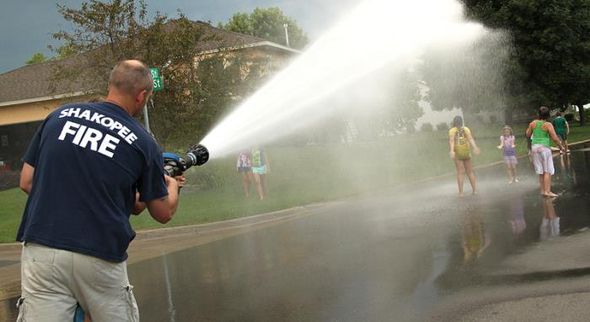
Tradition v Potential
Tradition
Potential

Slide 13
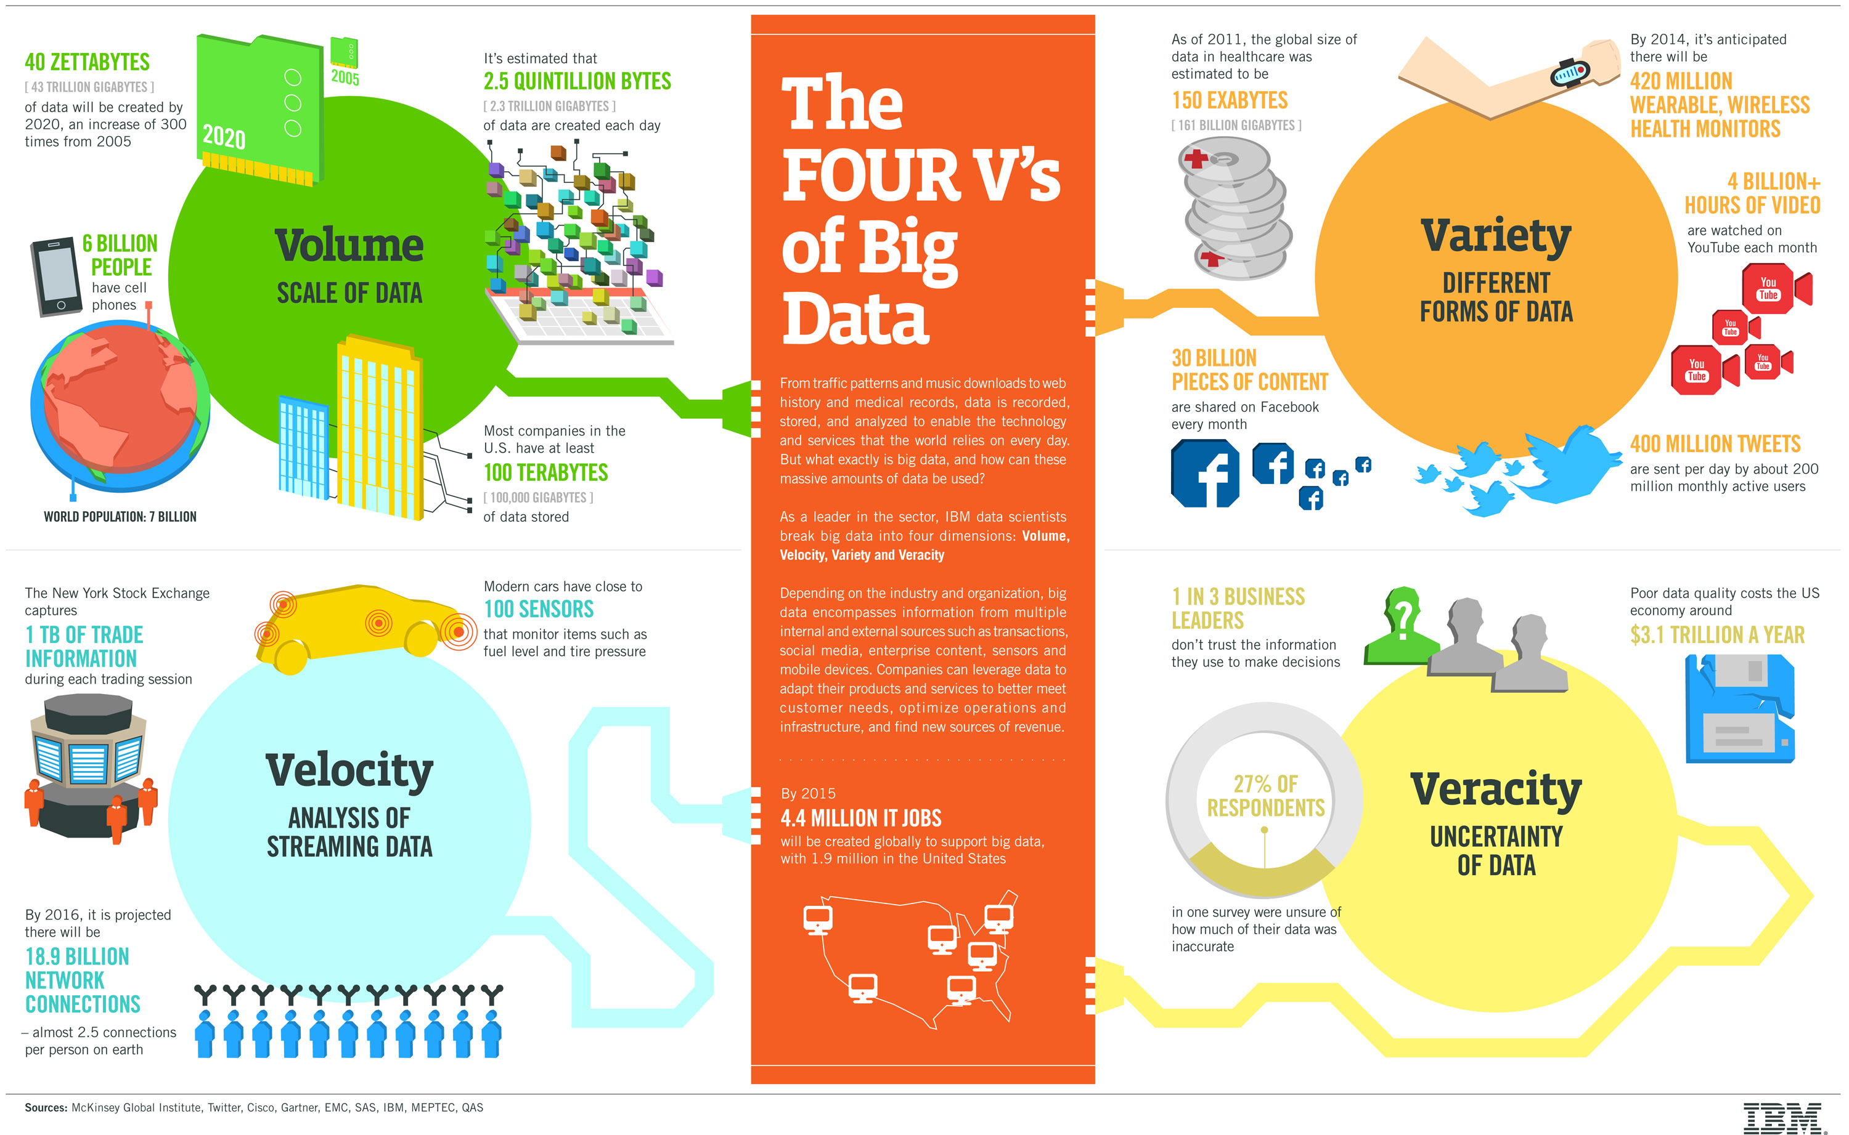

Slide 14
Big Data in the real world
Indicators of rising real estate values: New Starbucks, grocers, restaurants, bars
Target mailing baby product-related coupons to a 15-year-old shopper who had not told anyone she was pregnant
Notes:
Big Data – drawing conclusions from seemingly unrelated facts

Slide 15
What Big Data knows about you
Whether or not you brushed your teeth and filled your car with gas before going to Starbuck’s to get that tall skinny latte while wearing your SweatyBetty yoga pants.

Slide 16
Big Data in the Health Care
Google’s algorithm can tell if someone is at risk for a heart attack or stroke just by looking at their eyes – with 70% accuracy.
AI can determine an individual’s end of life –90% of the time.

Slide 17
Big Data and common sense
Zip code continues to be key indicator of health.
EHR – a treasure trove of date for Nursing to mine
Mining the EHR requires “law library” skills. You don’t have to know it all. You just have to know how to find what you need it when you need it.
CNIOs need a doctorate to harvest and analyze Big Data accurately. (AMIA 2014)
Notes:
In 2010, there were an estimated 5,419,000 crashes, 30,296 with fatalities, killing 32,999, and injuring 2,239,000. About 2,000 children under 16 die every year in traffic collisions. Records indicate that there were 3,613,732 motor vehicle fatalities in the United States from 1899 to 2013.

Slide 18
Emory’s SON Center for Data Science called NeLL
Re: IRB Submission
Nell Hodgson Woodruff School of Nursing Center for Data Science by
NeLL contains 811,771,561 unique
electronic records from 1,089,586 unique patients, a 17% random sample of all patients seen at Emory Health-
care (EHC) between 2012 and 2019. The records were taken from the clinical data warehouse (CDW) and
de-identified by EHC IT to remove all protected health information. The dataset contains patients’ demographics,
orders, procedures, diagnoses, laboratory results, medication history, administered medications, physiological
measurements (e.g., blood pressure, temperature, etc.), and nursing notes.

Slide 19
Example
“…tensor factors are reported as phenotype candidates that automatically reveal
patient clusters on specific diagnoses and medications.”
31 815 patient records over 7 years in the Geisinger Health System
Heart failure onset prediction study
J Biomed Inform. 2014 Dec;52:199-211. doi: 10.1016/j.jbi.2014.07.001.

Slide 20
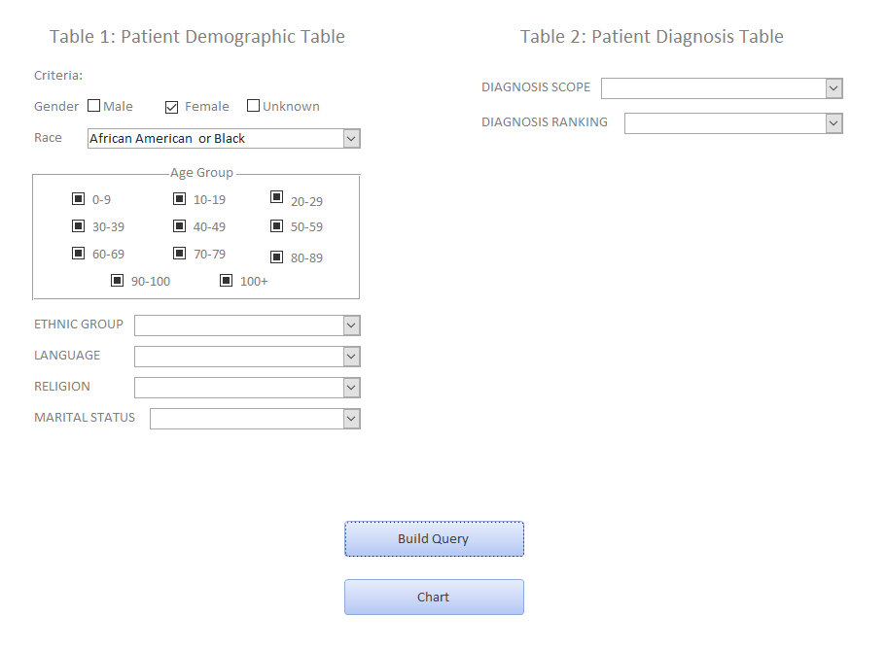
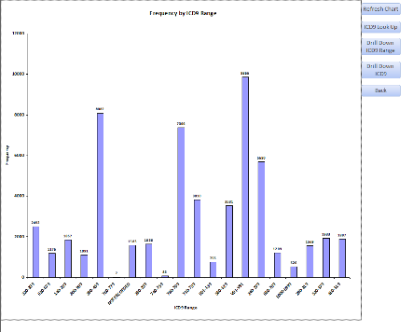
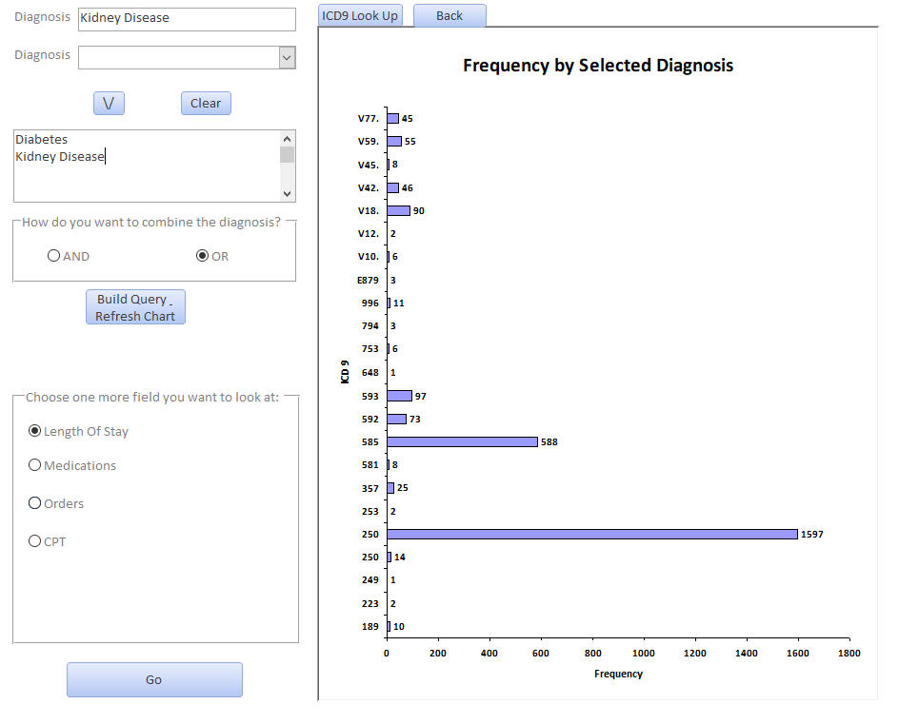
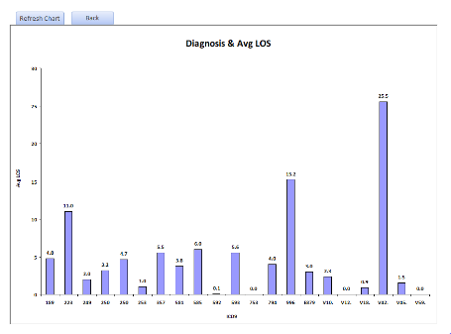
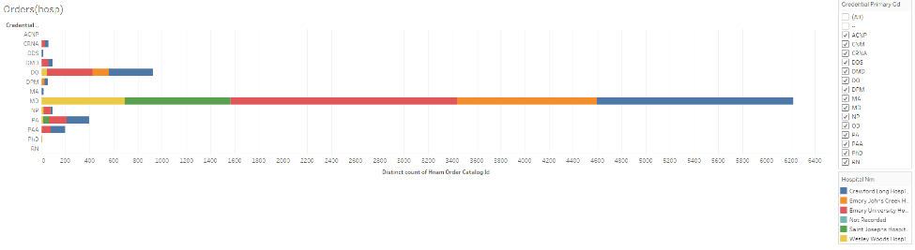
Making Use of Electronic Health Record Data for Nursing Research
Mengtian Jin, Emory University; Andi Plotsky, MSPH, Emory University
Background
The power of data to affect policy is increasingly being used in numerous fields. Emory Healthcare’s electronic health record (EHR) data warehouse has sufficient data for nurses and other researchers to examine hospital procedures and outcomes in order to affect policy. However, until now, there has been a lack of easy-to-use data exploration tools for nurses to use for this purpose. Students and researchers need these tools to facilitate examination of the data and hypothesis development.
The Nell Hodgson Woodruff School of Nursing of Emory University created the Center for Nursing Data Health eRecord (CeNDHeR) dataset extracted from the EHR data warehouse in order to test the use of EHR data for nurses.
Interface Demo
Challenges
Learning about the US Healthcare System and medical terminologies.
Speed issues:
Connecting a desktop Tableau to an Oracle RDS in an Emory AWS caused speeding issues in Tableau
Complicated subqueries in Access slowed down the searching speed
Restrictions caused by database normalization rules:
Increased times of joining tables;
One to many relationship.
Missing data.
Keeping data extracts secure so they can’t be downloaded in their entirety.
Objectives
Test the efficacy of the CeNDHeR Oracle database for the purpose of nursing research
Build a functional interface which has the following features:
Easy to use;
Flexible and comprehensive such that it is usable for almost any possible question (“use case”);
Fast speed and return accurate results;
Security preventing users from downloading entire database.
Step1: Select demographic and ICD-9 diagnosis group(s) as criteria of interest
Step 2: Resulting display of frequency of diagnosis, based upon selection criteria.
Progress to Date
Data were partially cleaned.
5 well-established use cases built in Tableau.
3 functional use cases developed in ACCESS.
Generalized forms are in progress:
Tables and their related fields from the database can be automatically presented after the users click on the use cases of interested;
Users can build their own use cases from the available tables and fields;
Users can further drill down through the use cases by adding more criteria or summarizing the data based on different fields.
Methodology
CeNDHeR Database: Oracle database of 20,000 randomly selected patients at Emory Healthcare (2012-2014). All private health information was removed in compliance with HIPAA requirements before we received the data.
Tables included in the database:
Data were stored on Amazon Web Services (AWS) cloud.
Used SQL to clean, explore and manipulate the data within the Oracle database.
Used Tableau and Microsoft Access to develop several use cases of visualizing the data.
Tested speed and efficacy of:
Tableau vs Access interfaces
Emory AWS vs non-Emory AWS
a direct connection vs extract (Tableau)
indexed fields vs non-indexed fields.
Developed a comprehensive data interface in Microsoft Access by VBA and SQL coding.
Next Steps
Developed documentation and a user manual for the database.
Expand the database to 100,000 patients
Further clean the data based on the needs
Optimize the back-end SQL queries to speed up the search.
Generalize the use cases to include every possible table, field and their combinations
Test the possibility of a de-normalized, noSQL database.
Web enable the database, which will be based on the protocol already developed.
Patient Demographics
Diagnosis
Orders
CPT (common procedures)
PowerForm
Hospital Visit
Medication History
Medications Administered
Lab Records
Step 3: Further select exact diagnoses of interest (blue box) and outcome variable (red box)
Step 4: Drill down: Diagnosis and their corresponding average length of stay
Fig 1: Diagnosis Use Case By Access VBA
Acknowledgement
Thanks to Dr. Roy L. Simpson for healthcare system and nursing system advising, Dr. Vicki Hertzberg and Emory SURE program for professional support. The project is funded by Center for Data Science of Nell Hodgson Woodruff School Of Nursing.
Fig 2: Orders Use Case By Tableau

Slide 21
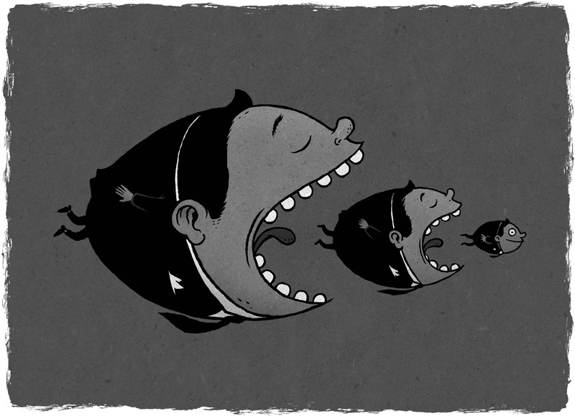
Capitalism reigns so let’s not forget technological obsolescence
Simpson Nursing Economics 2014
Notes:
We live and work in a capitalistic society.

Slide 22
In America, paychecks matter
Average CEO in America = $6,638 an hour
Average nurse = $26.44 an hour
42% of all American workers = $15 an hour
When did minimum wage become a benchmark?
Big data will be driven by economics!
Notes:
One that uses money to signify value.

Slide 23
Financial incentives shift behavior
Why does the same drug have a different price all over the city (Good RX)?
Price is based on investment, market share – not outcome
How can we get patients to “shop” for providers with best outcomes?
How do we reward nurses who get better patient outcomes?
Notes:
We can use financial incentives (savings, BOGOs, coupons) to shape consumer behavior. Why not do that in health care too?
Not advocating couponing but am recommending we prove our value.

Slide 24
Question
The Finance Department presents you with five spreadsheets that summarize last quarter’s staff levels by shift, floor and unit.
Do you have Big Data?
True
False
Notes:
FALSE – no way to ask intelligent questions of overlaid variables and get results quickly and efficiently.

Slide 25
Big Data Types and their Value
Prescriptive – A laser focus to answer specific questions. Extremely valuable and largely not used. Produces next steps. People think their odds are better than the data indicates.
Predictive – Identifies past patterns to predict complex forecasts.
Diagnostic – Determining what worked and what didn’t – and why.
Descriptive – Figuring out what is happening now. Least valuable.

Slide 26

Cold, Calculating Data
Notes:
Cold, calculating data has no agenda and no loyalty to any position or side.

Slide 27
The real value of Big Data
Aggregating individual data sets into big-data algorithms spots nuances in sub-population so rare that they may not be apparent in small samples.

Slide 28
Question 3
Find the odd woman out - 1050, 510, 242, 106, 46, 16, 3
a) 510
b) 242
c) 106
d) 46
Notes:
Solution:
2nd term = (Ist term - 30) / 2 = (1050-30)/2 = 510
3rd term = (2nd term - 26) / 2 = (510-26)/2 = 242
4th term = (3rd term - 22) / 2 = (242-22)/2 = 110
So 106 is the answer.

Slide 29
17 years is a lifetime to wait
It takes 17 years for research to reach the bedside.
It’s the nurse, not the data.
Stakeholders understand that Big Data could slash the wait time and accelerate Best Practices
What do we need to do to help Nursing handle rapid change?
Professional journals give dates of submission, dates of acceptance and dates of publishing.
Proprietary or Not for Profit journals ????

Slide 30
WHAT ARE ’OMICS
Genomics
Lipidomics
Proteomics
Glycomics
Foodomics
Transcriptomics
Metabolism
Nutrition, pharmacology, and toxicology
Culture
Notes:
Kinds of omics studies[edit]
Genomics[edit]
Genomics: Study of the genomes of organisms.
Cognitive genomics examines the changes in cognitive processes associated with genetic profiles.
Comparative genomics: Study of the relationship of genome structure and function across different biological species or strains.
Functional genomics: Describes gene and protein functions and interactions (often uses transcriptomics).
Metagenomics: Study of metagenomes, i.e., genetic material recovered directly from environmental samples.
Neurogenomics: Study of genetic influences on the development and function of the nervous system.
Personal genomics: Branch of genomics concerned with the sequencing and analysis of the genome of an individual. Once the genotypes are known, the individual's genotype can be compared with the published literature to determine likelihood of trait expression and disease risk. Helps in Personalized Medicine
Epigenomics
The epigenome is the supporting structure of genome, including protein and RNA binders, alternative DNA structures, and chemical modifications on DNA.
Epigenomics: Modern technologies include chromosome conformation by Hi-C, various ChIP-seq and other sequencing methods combined with proteomic fractionations, and sequencing methods that find chemical modification of cystosines, like bisulfite sequencing.
Nucleomics: Study of the complete set of genomic components which form "the cell nucleus as a complex, dynamic biological system, referred to as the nucleome".^{[10][11]}The 4D Nucleome Consortium officially joined the IHEC (International Human Epigenome Consortium) in 2017.
Lipidomics[edit]
Lipidome is the entire complement of cellular lipids, including the modifications made to a particular set of lipids, produced by an organism or system.
Lipidomics: Large-scale study of pathways and networks of lipids. Mass spectrometry techniques are used.
Proteomics[edit]
Proteome is the entire complement of proteins, including the modifications made to a particular set of proteins, produced by an organism or system.
Proteomics: Large-scale study of proteins, particularly their structures and functions. Mass spectrometry techniques are used.
Immunoproteomics: study of large sets of proteins (proteomics) involved in the immune response
Nutriproteomics: Identifying the molecular targets of nutritive and non-nutritive components of the diet. Uses proteomics mass spectrometry data for protein expression studies
Proteogenomics: An emerging field of biological research at the intersection of proteomics and genomics. Proteomics data used for gene annotations.
Structural genomics: Study of 3-dimensional structure of every protein encoded by a given genome using a combination of experimental and modeling approaches.
Glycomics[edit]
Glycomics is the comprehensive study of the glycome i.e. sugars and carbohydrates.
Foodomics[edit]
Foodomics was defined in 2009 as "a discipline that studies the Food and Nutrition domains through the application and integration of advanced -omics technologies to improve consumer's well-being, health, and knowledge"
Transcriptomics[edit]
Transcriptome is the set of all RNA molecules, including mRNA, rRNA, tRNA, and other non-coding RNA, produced in one or a population of cells.
Transcriptomics: Study of transcriptomes, their structures and functions.
Metabolism[edit]
Metabolomics: Scientific study of chemical processes involving metabolites. It is a "systematic study of the unique chemical fingerprints that specific cellular processes leave behind", the study of their small-molecule metabolite profiles
Metabonomics: The quantitative measurement of the dynamic multiparametric metabolic response of living systems to pathophysiological stimuli or genetic modification
Nutrition, pharmacology, and toxicology[edit]
Nutritional genomics: A science studying the relationship between human genome, nutrition and health.
Nutrigenetics studies the effect of genetic variations on the interaction between diet and health with implications to susceptible subgroups
Nutrigenomics: Study of the effects of foods and food constituents on gene expression. Studies the effect of nutrients on the genome, proteome, and metabolome
Pharmacogenomics investigates the effect of the sum of variations within the human genome on drugs;
Pharmacomicrobiomics investigates the effect of variations within the human microbiome on drugs.
Toxicogenomics: a field of science that deals with the collection, interpretation, and storage of information about gene and protein activity within particular cell or tissue of an organism in response to toxic substances.
Culture
Inspired by foundational questions in evolutionary biology, a Harvard team around Jean-Baptiste Michel and Erez Lieberman Aiden created the American neologism culturomics for the application of big data collection and analysis to cultural studies.
Miscellaneous
Mitointeractome
Psychogenomics: Process of applying the powerful tools of genomics and proteomics to achieve a better understanding of the biological substrates of normal behavior and of diseases of the brain that manifest themselves as behavioral abnormalities. Applying psychogenomics to the study of drug addiction, the ultimate goal is to develop more effective treatments for these disorders as well as objective diagnostic tools, preventive measures, and eventually cures.
Stem cell genomics: Helps in stem cell biology. Aim is to establish stem cells as a leading model system for understanding human biology and disease states and ultimately to accelerate progress toward clinical translation.
Connectomics: The study of the connectome, the totality of the neural connections in the brain.
Microbiomics: the study of the genomes of the communities of microorganisms that live in the digestive tracts of animals.
Cellomics: Is the quantitative cell analysis and study using bioimaging methods and bioinformatics.
Tomomics: A combination of tomography and omics methods to understand tissue or cell biochemistry at high spatial resolution, typically using imaging mass spectrometry data.^{[12]}
Ethomics: Is the high-throughput machine measurement of animal behaviour.[Videomics (or vide-omics): A video analysis paradigm inspired by genomics principles, where a continuous image sequence (or video) can be interpreted as the capture of a single image evolving through time through mutations revealing ‘a scene

Slide 31
Big Data Discoveries at Emory
Why migrant workers develop kidney failure at 40
Why African-Americans have more complications in childbirth
Notes:
No breaks from picking produce to drink water
Microbioms example

Slide 32
EHR
Data Preprocessing
Transformation
Diagnostic
Imaging
Cleaning
Missing Values
Noisy Removal
Integration
Redundancy
Data Conflicts
Correlation Analysis
Covariance Analysis
Reduction
Wavelet Transform
Principal Component Analysis
Decision Tree (subselect)
Regression Analysis
Smoothing
Attribute Construction
Aggregation
Normailization
Discretationzation
Clustering
Binning
Histogram Analysis
Concept Hierarchy
Pharma
Clinical
(Vitals)
SELECTION
Medical
(procedures)
Historical
Data Mining
Notes:
This complicated chart shows how data becomes more valuable over time. Let me walk you through it.

Slide 33
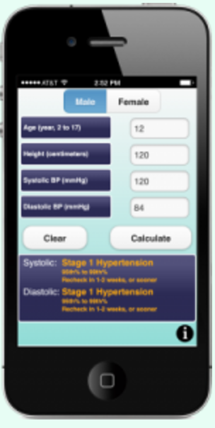
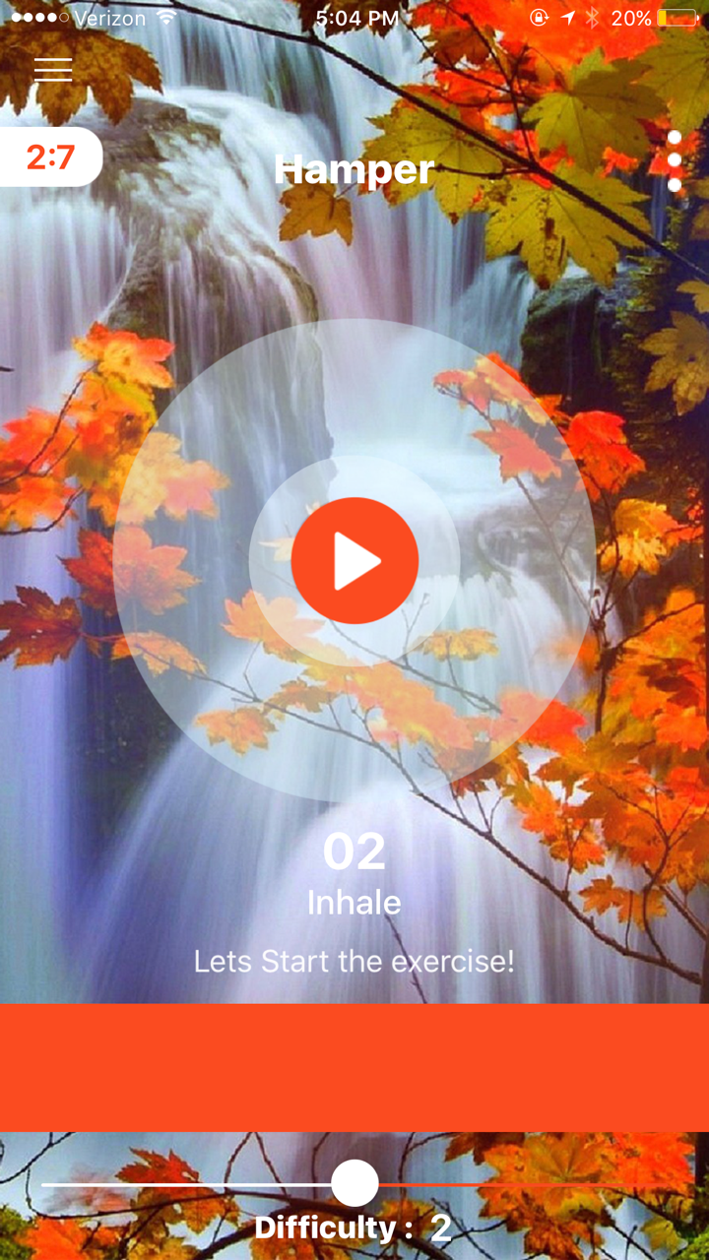
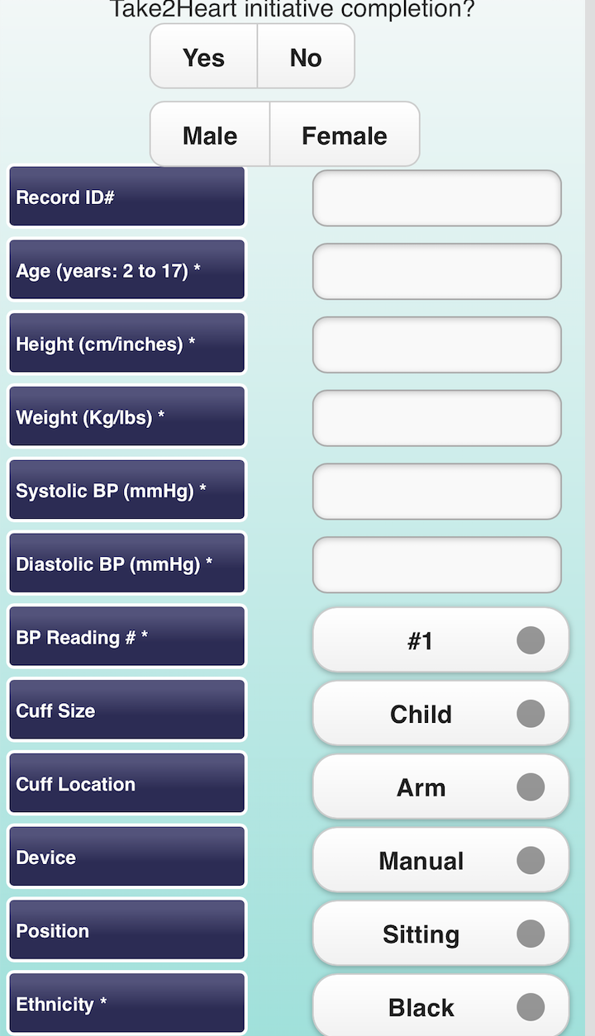
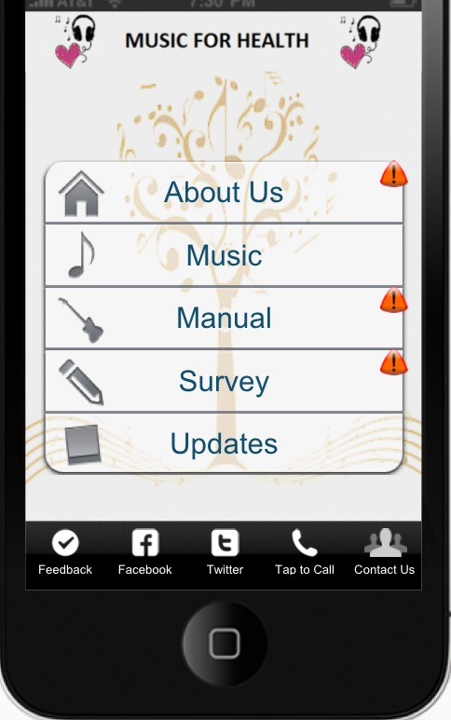

Outcomes Beyond Emory
COPD Pulmonary breathing therapy
Music motivation & education for HIV patients
Pediatric blood pressure measurement
Personalized technology to support health
E-tech companion
Simple C
Technology Interest Group (TIGr)
Monthly meeting of
Emory & GA Tech faculty
& corporations
Dementia Care
X&Y Chromosome
CENTER FOR DATA SCIENCE
Notes:
Use pointer or ID app you are discussing
Mention these are currently being tested in the marketplace
Hi Vicki,
Please see attached and below description. Let me know if more is needed. Thanks.
Pedia BP, a free smartphone application, was developed to improve evidence-based clinical practice by simplifying the process of interpreting a pediatric blood pressure measurement and saves a significant amount of time.
Hope Bussenius DNP, APRN, FNP-BC
Pediatric and Adolescent Hyper-tension PI: Hope Bussenius, DNP, APRN, FNP-BC
Hypertension and pre-hypertension in the pediatric population is on the rise. The development of these conditions earlier in life increases the chances of cardiovascular morbidity and mortality later in life. Pedia BP, a free smartphone application, was developed to improve evidence-based clinical practice by simplifying the process of interpreting a pediatric blood pressure measurement. Researchers implemented this application in two international community-based programs in Haiti and the Dominican Republic. During well-child checks of 389 children, nurse practitioner students observed an increase in the number of initial elevated blood pressure readings. With the use of health care informatics technology, like the Pedia BP program, pediatric hypertension may be better interpreted and ultimately managed.
Weihua’s Project Weihua Zhang has developed a hand-held device in partnership with Georgia Tech and the VA Medical Center, that enables patients to complete their pulmonary rehabilitation for chronic obstructive pulmonary disease (COPD) at home. Patients with COPD must undergo several hours of pulmonary therapy 3-4 times a week at a hospital or outpatient clinic. The accessibility of these services is often a barrier to patients in successfully completing pulmonary rehabilitation programs that could slow the progression of their disease, reduce its symptoms, and improve their quality of life. The device coaches patients through their breathing exercises and enables patients to complete therapy at their convenience at home. The device is currently in use at Emory-St. Joseph’s Hospital, the VA Medical Center, and Emory University Hospitals and has a patent is pending.

Slide 34
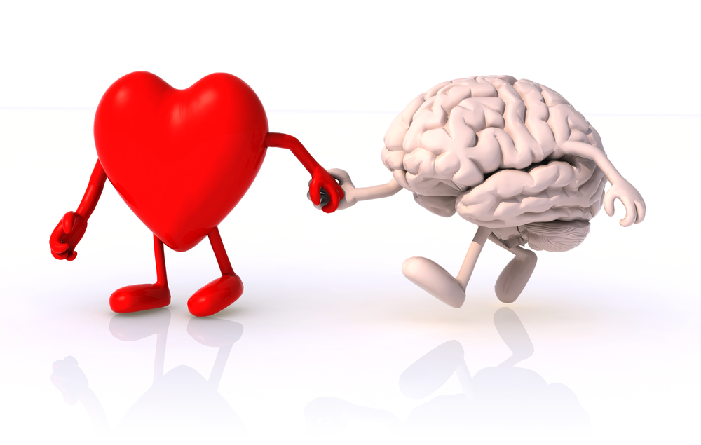
Heartfelt Connection Model- How Nurses are to thrive and survive?
Notes:
Here’s a true story that illustrates how the Heartfelt Connector fundraising model works.
The foundation was established in 1982. Now a network of 125 affiliates with a shared purpose: to eradicate a specific disease condition.
1997: raised $47 MILLION
2007: raised $334 MILLION
Average donation: $33
Foundation benefits from deep resonance with women, many of whom will never benefit directly.
The foundation we are talking about is one you probably know well – Susan G. Komen Foundation.
Keep in mind that breast cancer affects about 12% of the country’s female population each year.

Slide 35
Why Nursing Research
Perfectly Qualifies for
The Heartfelt Connector Model
Notes:
Access to a large cross-section of people with gift-giving ability
Compelling value proposition
Ability to attract and involve larger numbers of volunteers
In-house capability to attempt broad outreach in even one geography

Slide 36
Lack of science-based funding
Nursing is not funded like other medical professions.
Nursing is NOT part of STEM. https://www.google.com/url?sa=t&rct=j&q=&esrc=s&source=web&cd=17&ved=2ahUKEwiEquSj1LThAhWDPN8KHQtcANUQFjAQegQICBAC&url=https%3A%2F%2Fwww.bls.gov%2Foes%2Fstem_list.xlsx&usg=AOvVaw3LIMmEzCmuoRUpUkIHWnXk
Attracting science-based funding to enable data-driven determinations of Nursing’s value.

Slide 37

Carve out a place for…
Notes:
In a financially driven world, how do we charge for nursing’s unique contribution to patient care: compassion? Big Data can help by providing the evidence needed to value nursing compassion.

Slide 38
How Heartfelt Connection Works
Heartfelt Connector Model
Characteristics | Nursing
Large cross-section of people with gift-giving ability
Compelling value proposition
Ability to attract, involve large numbers of volunteers
Able to go broad – even if only in one geography

Slide 39
Nursing Practice Defined
“…and advocacy in the care of individuals, families, communities, and populations.”
-- ANA
Who advocates for Nursing?
Notes:
A radical idea: Nurses should advocate for the profession. It is up to us.

Slide 40
Timing really is EVERYTHING
A dollar today is worth more than a dollar tomorrow. This statement underpins all of finance.
Venture capitalist Tomasz Tunguz,

Slide 41
Question
If every active nurse in America gave $10 a year for five years, how much would you have?
4.1 million nurses X $51 (5% interest) equals =$209,100,000.00
NIH Current budget is $30.1 Billion
The NINR budget for 2018 was
$113,688,000.00
Notes:
Confused about the numbers here. In our meeting, you said the donations would through off $24 million a year for nursing research without touching the prin. Is that correct? Also, I looked up NIH’s current budget - $30.1 BILLION

Slide 42
Your Next Steps
Get started
Lead by example
Recognize that it’s wrong to ask anyone to donate to the point it affects their quality of life.

Slide 43
Selected References
Sivarajah,Uthayasankar, etc. Critical analysis of Big Data Challenges and analytical methods; Journal of Business Research 2016; doi.org/10.1016/j.jbusres.2016.08.01
NIH Strategic Plan for Data Science available at https:..www.nih.gov/sites/default/files/about-nih/strategic-plan-fy2016-2020-508.pdf
J Nurs Scholarsh. 2015 Sep;47(5):477-84. doi: 10.1111/jnu.12159. Epub 2015 Aug 19.Nursing Needs Big Data and Big Data Needs Nursing.Brennan PF¹, Bakken S². DOI: 10.1111/jnu.12159
Simpson; Big Data: the evidence nursing needs to spark Advocacy presentation USC April 2017
What about big data and nursing? American Nurse Today, May 2018 Vol. 13 No. 5 Author(s): Melinda Higgins, PhD; Roy L. Simpson, DNP, RN, FAAN, DPNAP, FACMI; William Gregory Johnson
Emerson, etc. Tool Kit- Don’t drown in the data, 2012 The Royal Statistical Society, August 2012- Significance
AMIA; Appl Clin Inform 2016; 07(01): 143-176 DOI: 10.4338/ACI-2015-12-R-0174

Slide 44
Thank you!
Roy L. Simpson, DNP, RN, DPNAP, FAAN, FACMI
Nell Hodgson Woodruff School of Nursing
Emory University
roy.l.simpson@emory.edu

